Slide 1
Web Security

Slide 2
HTTP Authentication
Protect web content from those who don’t have a “need to know”
Require users to authenticate using a userid/password before they are allowed access to certain URLs
HTTP/1.1 requires that when a user makes a request for a protected resource the server responds with a authentication request header
  WWW-Authenticate
    contains enough pertinent information to carry out a “challenge-response” session between the user and the server
Client requests a protected resource
Client
Web Server
Server responds with a 401 (not
authorized and a challenge request
for the client to authenticate

Slide 3
Client Response
Well established clients like Firefox, Internet Explorer …. will respond to the challenge request (WWW-Authenticate) by presenting the user with a small pop-up window with data entry fields for
  userid
  password
  a Submit button and a Cancel button
entering a valid userid and password will post the data to the server, the server will attempt authentication and if authenticated will serve the originally requested resource.

Slide 4
WWW-Authenticate
The authentication request received by the browser will look something like:
  WWW-Authenticate = Basic realm=“defaultRealm”
    Basic indicates the HTTP Basic authentication is requested
    realm indicates the context of the login
      realms hold all of the parts of security puzzle
        Users
        Groups
        ACLs (Access Control Lists)
Basic Authentication
  userid and password are sent base 64 encoded (might as well be plain text)
  hacker doesn’t even need to unencode all he has to do is “replay” the blob of information he stole over and over ( this is called a “replay attack”)

Slide 5
WWW-Authenticate
Digest Authentication
  attempts to overcome the shortcomings of Basic Authentication
  WWW-Authenticate = Digest realm=“defaultRealm” nonce=“Server SpecificString”
  see RFC 2069 for description of nonce, each nonce is different
  the nonce is used in the browser in a 1-way function (MD5, SHA-1….) to encode the userid and password for the server, this function essentially makes the password good for only one time
Common browsers don’t use Digest Authentication but an applet could as an applet has access to all of the Java Encryption classes needed to create the creation of a Digest.

Slide 6
WWW-Authenticate
Secure Sockets Layer (SSL)
  Invented by Netscape and made public domain for everyone’s use
  An additional layer to the TCP/IP stack that sits between the Application and Transport layers
    ensures that all application data is encrypted but TCP/IP headers are not
    usually run on port 443 (default HTTPS port)
Public Key Cryptography
  owner of a private key sends a public key to all who want to communicate with him (keys are both prime factors of a large (1024 bit) number). Owner keeps the private key secret and uses it to decrypt information sent to him that has been encrypted with the public-key
  RSA algorithm is most notable public-key cipher algorithm
Digital Certificates
  issued by a disinterested third party (ex. Verisign)
  the Certificate contains the public-key for the specific Web Server and a digital signature of the certifying authority

Slide 7
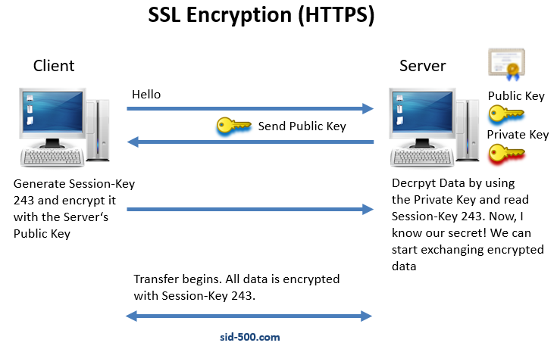
WWW-Authenticate

Slide 8
back to SSL
Once a secure session is established the source requests the destinations certificate ( sent in the http header (uncncrypted))
once the source accepts the authenticity of the certificate it uses the public-key from the certificate to encrypt the generated session key for protecting the conversation between the source and destination.
Session is encrypted using a symmetric cipher (slow)
conversation is encrypted using an asymmetric cipher (fast)
its done this way to speed up overall communications, strong encryption (slow) is used as little as possible while weaker encryption is used for most exchanges
actual cipher algorithms are negotiated on a per-session basis

